Slide 1
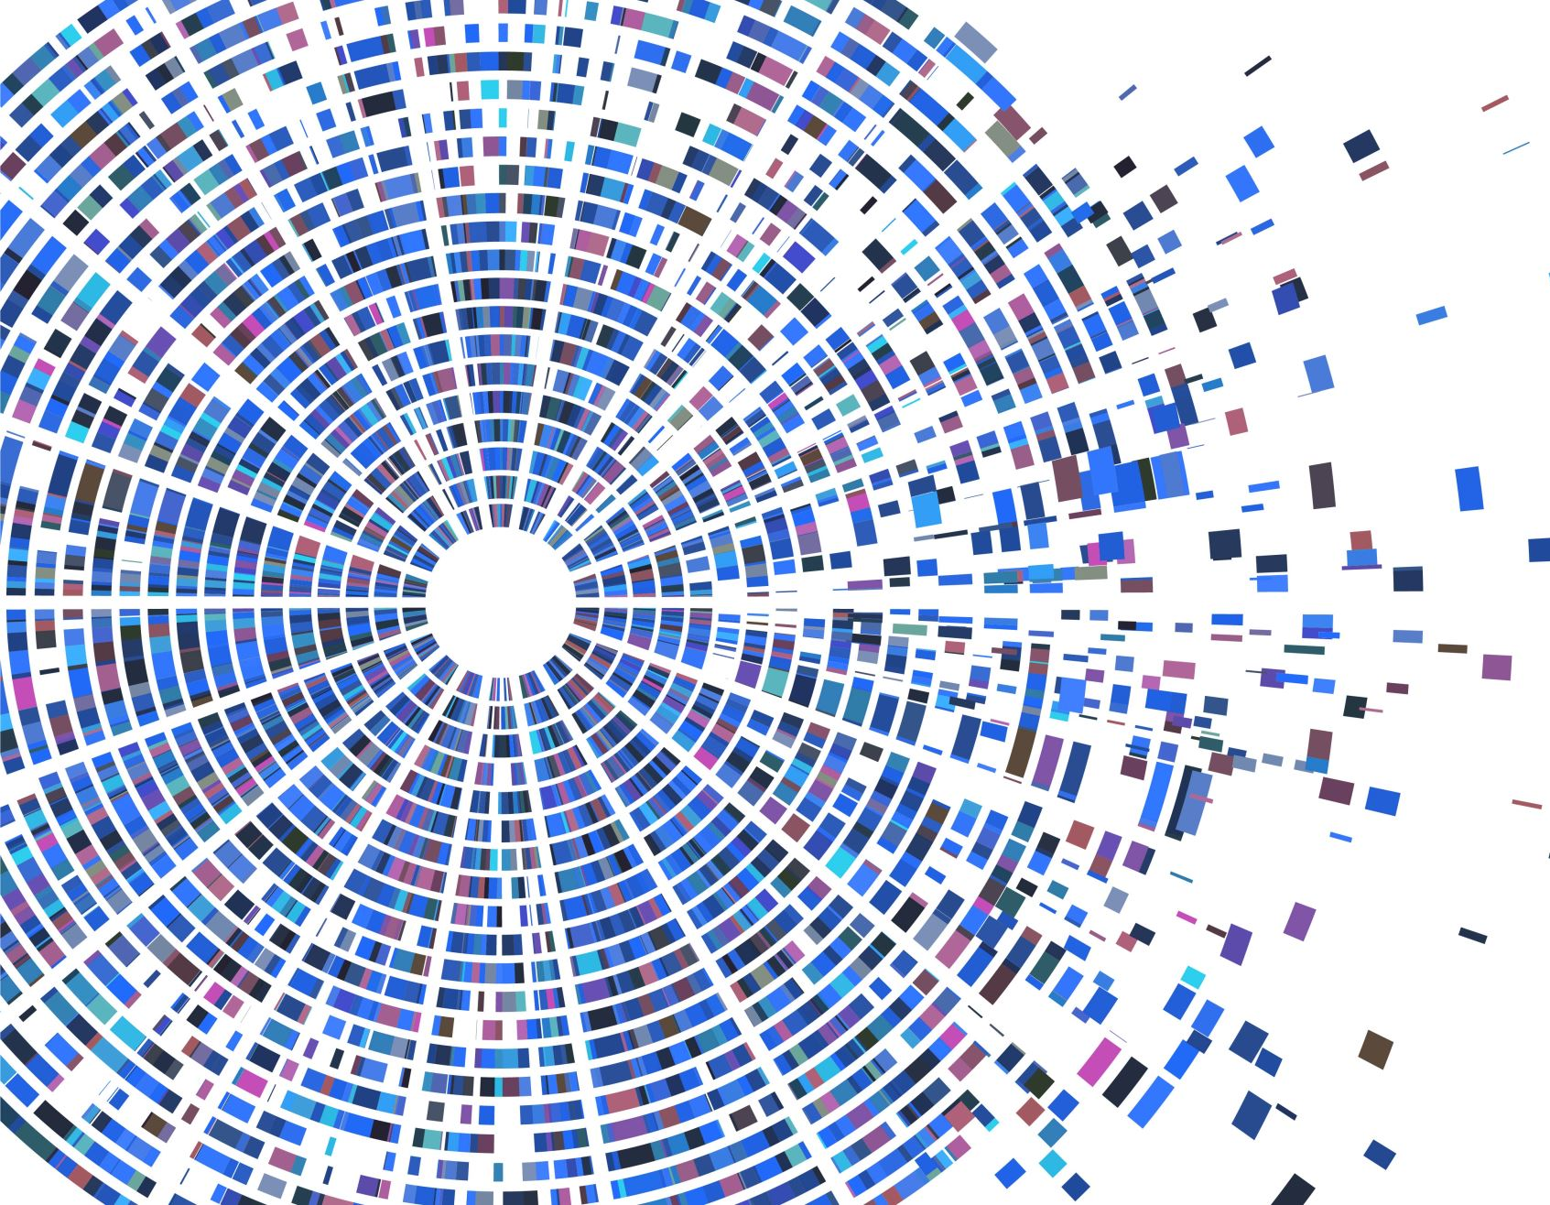
CONTAINERIZATION & DEPLOYMENT

Slide 2
CONTAINERIZATION
Software deployment process that bundles an application’s code with all the files and libraries it needs to run on any infrastructure.
Abstracted away from the host operating system
Standalone and portable—able to run across any platform or cloud, resource-efficient
Allows developers to create and deploy applications faster and more securely

Slide 3
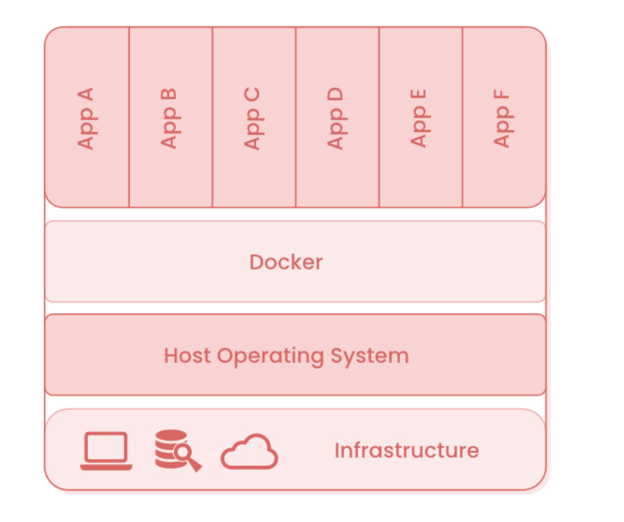
Layers of Containerization
Hardware infrastructure
Host operating system
Container engine
Containerized apps

Slide 4
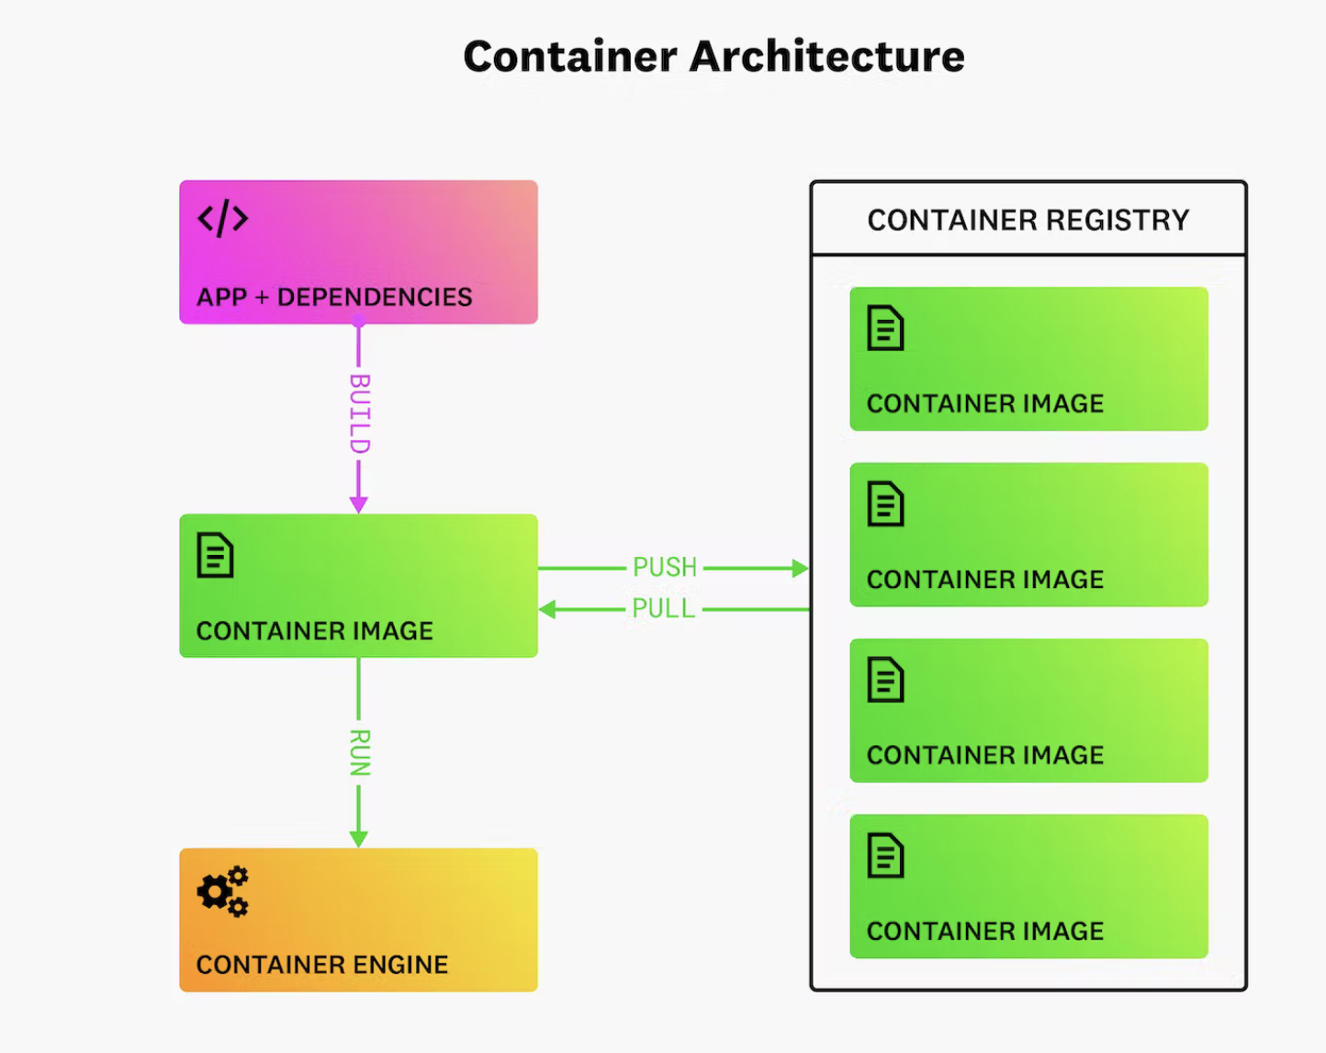
Container architecture

Slide 5
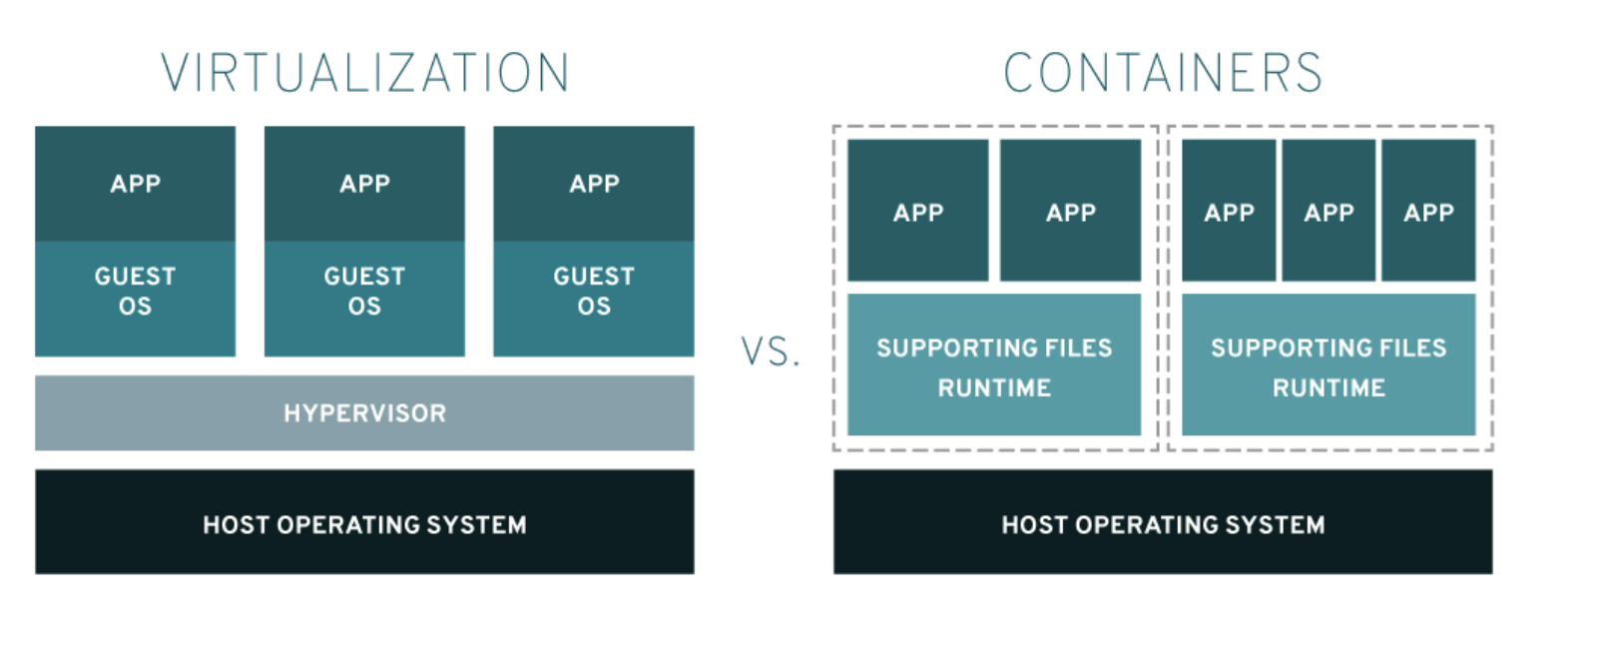
Container vs Virtual Machine

Slide 6
benefits of containerization
Portability
Agility
Speed
Fault isolation
Efficiency
Ease of management
Security

Slide 7
Types of containerization
Docker
Docker, or Docker Engine, is a popular open-source container runtime that allows software developers to build, deploy, and test containerized applications on various platforms. Docker containers are self-contained packages of applications and related files that are created with the Docker framework.
Kubernetes
Kubernetes is a popular open-source container orchestrator that software developers use to deploy, scale, and manage a vast number of microservices. It has a declarative model that makes automating containers easier. The declarative model ensures that Kubernetes takes the appropriate action to fulfil the requirements based on the configuration files.

Slide 8
Use Cases for Containerized Applications
Microservices
CI/CD pipelines
Databases
Repetitive jobs
DevOps

Slide 9
DOCKER

Slide 10
Why docker
Docker lets developers access these native containerization capabilities using simple commands, and automate them through a work-saving application programming interface (API)
Improved and seamless container portability
Even lighter weight
Automated container creation
Container versioning
Container reuse
Shared container libraries

Slide 11
DOCKER tools & terms
DockerFile - Simple text file containing instructions for how to build the Docker container image It’s essentially a list of command-line interface (CLI) instructions that Docker Engine will run in order to assemble the image.
Docker images
Docker images contain executable application source code as well as all the tools, libraries, and dependencies that the application code needs to run as a container Docker images are made up of layers, and each layer corresponds to a version of the image
Docker containers Docker containers are the live, running instances of Docker images Users can interact with them, and administrators can adjust their settings and conditions using Docker commands.
Docker Hub Public repository of Docker images All Docker Hub users can share their images at will. Can also download predefined base images from the Docker filesystem to use as a starting point for any containerization project.

Slide 12
Docker Desktop An application for Mac or Windows that includes Docker Engine, Docker CLI client, Docker Compose, Kubernetes, and others. It also includes access to Docker Hub.
Docker daemon Docker daemon is a service that creates and manages Docker images, using the commands from the client. Serves as the control center of your Docker implementation. The server on which Docker daemon runs is called the Docker host.
Docker registry Docker registry is a scalable open-source storage and distribution system for Docker images. The registry enables you to track image versions in repositories, using tagging for identification.
Docker Compose Manages multi-container applications, where all containers run on the same Docker host. Docker Compose creates a YAML (.YML) file that specifies which services are included in the application and can deploy and run containers with a single command.
Docker Swarm An orchestration management tool used for creating and deploying a cluster of Docker nodes

Slide 13
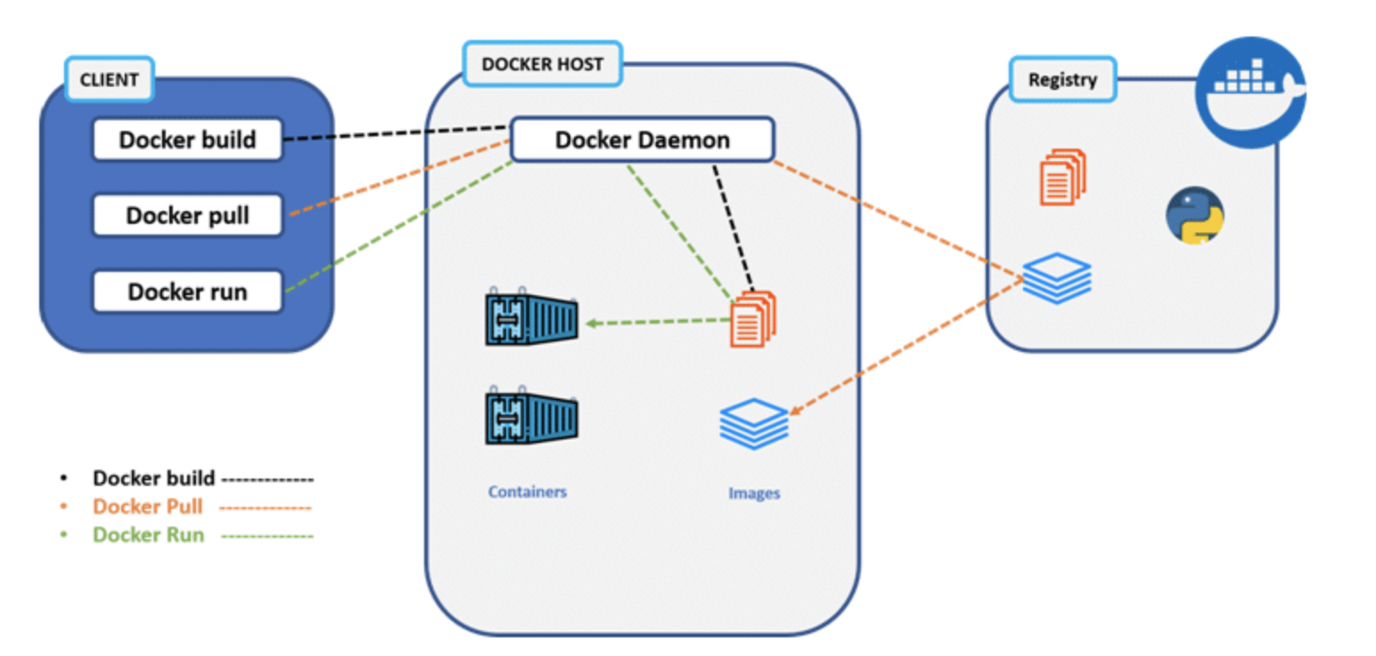
Architecture

Slide 14
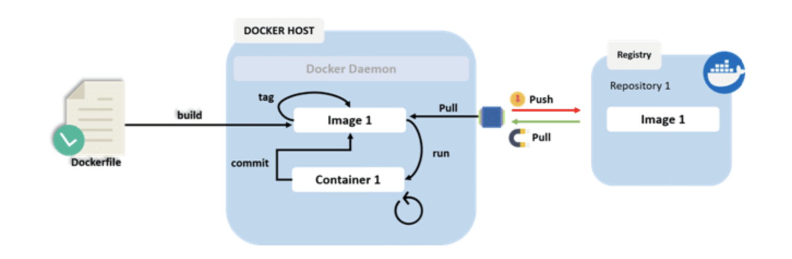
workflow

Slide 15
COMMANDS
install Docker from Download Docker, - https://docs.docker.com/desktop/ docker –v docker run hello-world docker ps –a docker pull <image> docker stop <container> docker rm <container>

Slide 16
HANDS ON..

